Slide 1
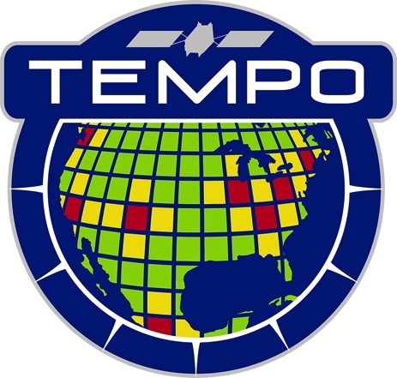

Nightlights Spectroscopy
J. Carr, Houria Madani
Carr Astronautics
1 May 2023
6404 IVY LANE SUITE 333 GREENBELT, MD 20770
Notes:
Version 10/23/2013

Slide 2
December 2015 Clear-Sky Mean VIIRS-DNB Radiances (NOAA/NGDC)
Remapped to the TEMPO Field of Regard and Resolution
Red > 1 nW sr⁻¹ cm⁻²
Yellow > 10 nW sr⁻¹ cm⁻²
White > 100 nW sr⁻¹ cm⁻²

Slide 3
TEMPO Nighttime Observing
Sun eclipsed
by Earth (umbra)
Allowed
nighttime
observing
Aperture door closed
while sun is < 60°
from optical axis
Increase Integration Time for Lower Signal
Daylight

Slide 4
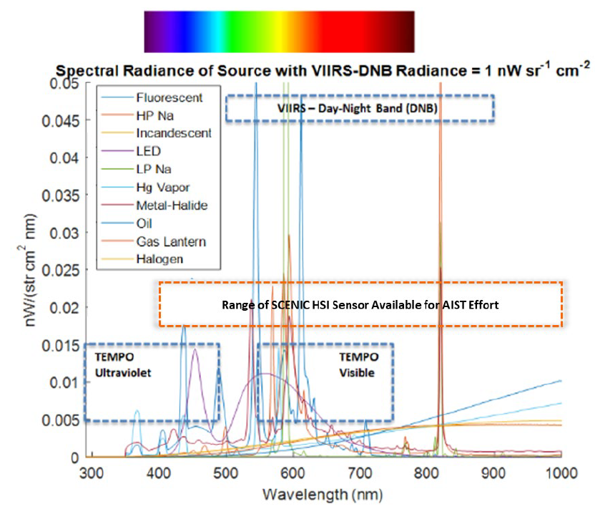
Spectral Classification
Understanding Lighting Types in use is Interesting for
Human Health
Ecology
Dark Night Skies
Energy Efficiency
VIIRS-DNB is a “Light Bucket” that cannot discriminate types
NASA Black Marble Collaboration
SCENIC is on the ISS

Slide 5
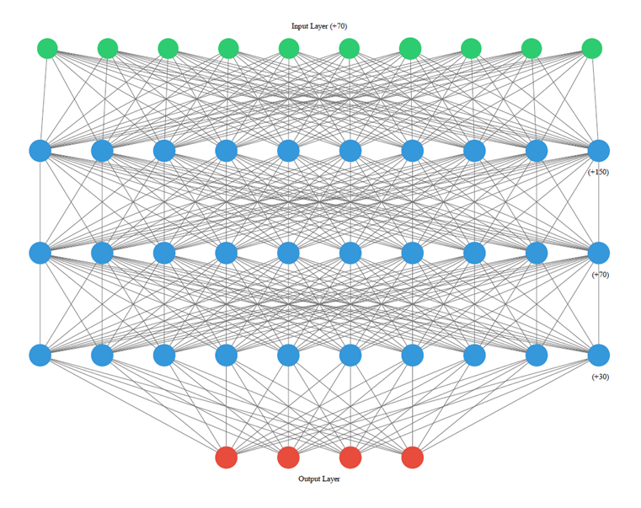
Neural Network Classifier
Spectral Projections onto Library of EOFs Reduce Dimensionality
Relu
Relu
Relu
Soft Max
HP Na
LED
LP Na
Hg
Funding: ESTO AIST-21 Program

Slide 6
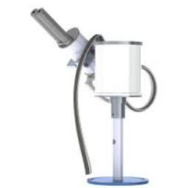
Pandora Test
Neural Network Retrieval
HP Na: 29%
LED: 60%
Hg Vapor: 11%
Pandora
Metro Washington
Roof B33
GSFC
Hg 546.074
Na 568.635
Courtesy: Dong Wu (GSFC)
Hg 579.066
Na 819.097
Hg 435.833
Na 498.281
Na 615.423
Na D Lines
NIST
LED
LED

